Slide 1




NARCCAP Multi-RCM Evaluations using RCMES: Monthly surface air temperatures and precipitation over the conterminous U.S.
NARCCAP Users' Workshop
10-11 April 2012
Boulder, Colorado
J. Kim¹, Waliser², C. Mattmann², L. Mearns³, C. Goodale² A. Hart². Crichton², S. Mcginnis³
¹: Joint Institute for Regional Earth System Sci. and Eng./UCLA
²: Jet Propulsion Laboratory/NASA
³: National Center for Atmospheric Research

Slide 2
Background: Regional Climate Model Evaluation
Recent studies have confirmed with high level of confidence that the emissions of anthropogenic greenhouse gases have induced the ongoing global warming trend.
Assessment of the impacts of climate change on regional sectors have become an important concern.
RCMs play a crucial role in climate change impact assessments.
Systematic evaluations of GCMs have been undertaken for some time (e.g., AMIP, CMIP); this is not the case for RCMs.

Slide 3
JPL Regional Climate Model Evaluation System (RCMES)
Facilitate Model Evaluation via User-friendly Data Infrastructure
Observational data are a key part of model evaluation
Typical model evaluation is performed by comparing the simulated and reference data from observations, analysis of observed data and/or observation-based assimilations.
Easy access to quality reference data facilitates evaluation efforts.
Remote-sensing at NASA & other institutions can provide fine-scale reference data suitable for evaluating future RCM simulations.
To facilitate RCM evaluation, especially for easy access to remote sensing data, RCMES has been developed via joint JPL-UCLA efforts.

Slide 4
RCMES High-level technical architecture
user
choice
RCM data
URL
TRMM
Metadata
Extract OBS data
Extract RCM data
MODIS
Data Table
User’s own codes for ANAL and VIS.
Data Table
Regridder
Put the OBS & RCM data on the same grid for comparison
AIRS
Extractor
MySQL
Data Table
Data extractor
(Fortran binary)
SWE
Data Table
Metrics Calculator
Calculate comparison metrics
Soil moisture
Data Table
Data extractor
(Fortran binary)
Data Table
Common Format,
Native grid,
Efficient architecture
Visualizer
Plot the metrics
ETC
Raw Data:
Various formats,
Resolutions,
Coverage
RCMED
(Regional Climate Model Evaluation Database)
A large scalable database to store data from variety of sources in a common format
RCMET
(Regional Climate Model Evaluation Toolkit)
A library of codes for extracting data from RCMED and model and for calculating evaluation metrics
Notes:
(1) The domain covers the entire African continent at a 0.44x0.44 deg resolution
(2) Six subregions are selected (1-6): Mediterranean, western sub-Sahara, central sub-Sahara, upper Nile, south-central sub-Sahara, and eastern RSA

Slide 5
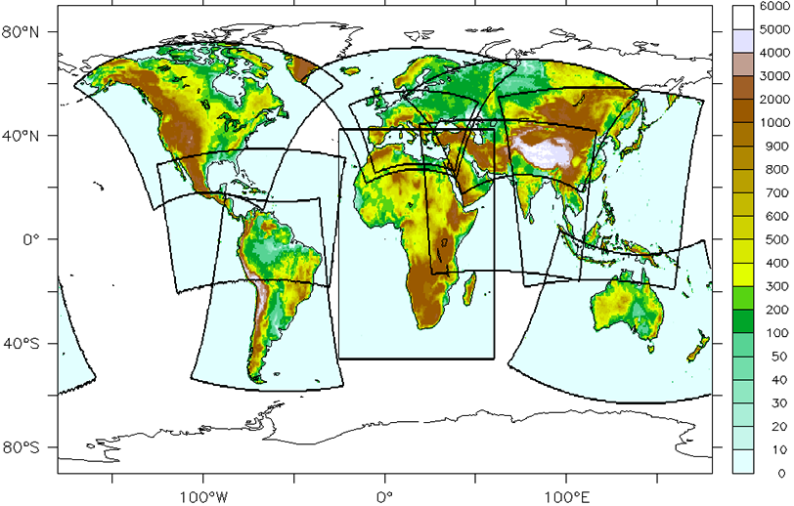
RCMES
Ongoing and planned application
Near-term applications to WCRP’s CORDEX for IPCC
N. America: Funded via NASA for U.S. NCA (NCAR, NARCCAP)
Africa: Collaboration & analysis ongoing (UCT, Rossby Centre)
Arctic: Exploring collaboration (J. Cassano, March 2012 Workshop)
E. Asia: Exploring collaboration (KMA, APCC)
Asia: Exploring collaboration
NARCCAP
Asia
E. Asia
AFRICA
Not Illustrated Here:
Arctic & Antarctic Domains

Slide 6
NARCCAP Multi-RCM Evaluation:
Monthly precipitation and surface air temperatures
The JPL-UCLA team is collaborating with NCAR scientists for providing inputs to National Climate Assessment report.
Monthly data from 5 RCMs for the 24-year (1980-2003) period are obtained on a common grid from NCAR.
Evaluations are performed for the monthly-mean values of:
Precipitation and the daily-mean surface air temperature
Reference data used:
CRU3.1 (1901-2010, 0.5deg)
Currently WIP:
Surface pressure (vs. MERRA Reanalysis data)
Surface insolation (vs. CERES radiation data)

Slide 7
RCMs and the Analysis Domain
The data from 5 RCMs and their ENS over the conterminous US region are evaluated.
The RCM simulations are interpolated onto a common grid nest of 0.5-deg horizontal resolution for analysis, evaluation, and inter-comparison.
Fourteen sub-regions (as shown in the figures and table) are selected to examine model performances in various regions of interests.
Model ID | Model Name
M01 | CRCM (Canadian Regional Climate Model)
M02 | ECP2 (NCEP Regional Spectral Model)
M03 | MM5I (MM5 – run by Iowa State Univ.)
M04 | RCM3
M05 | WRFG (WRF – run by PNNL)
ENS | Model Ensemble (Uniform weighting)

Slide 8
[1] The daily-mean surface air temperature evaluation 5 RCMs and their ensemble vs. CRU3.1 analysis
24 years: 1980-2003
Overland only
Annual climatology: Spatial variability
Seasonal climatology: Interannual variability
Annual cycle in subregions.

Slide 9
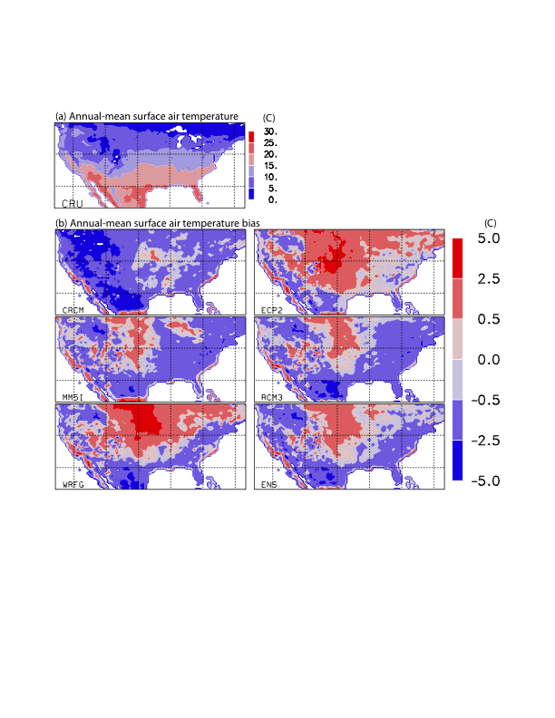
Daily-mean surface air temperatures: Climatology and Biases
Model errors varies systematically according to geography.
All models show cold biases over the coastal and the eastern US regions.
Most models show warm biases in the Great Plains region.
Model errors in the mountainous WUS region vary widely; may be related with large orographic variations in the region.
RCMs may experience difficulties in simulating the surface air temperatures in the mountainous WUS with their 50-km horizontal resolutions.

Slide 10
Surface air temperature climatology:
Spatial Variability over the land surface
Evaluation of the spatial variability of the simulated surface air temperature climatology using the Taylor diagram
Spatial pattern correlations
Spatial variability
RMSE
All models generate spatial patterns reasonably with pattern correlation coefficients of 0.95-0.99 with the CRU analysis.
The simulated spatial variability is also close to the observations.
The standardized deviation ranges from 0.9 to slightly above 1.
All models except CRCM underestimate the spatial variability.
The model ensemble (marked by a red circle) yields the smallest RMSE.

Slide 11
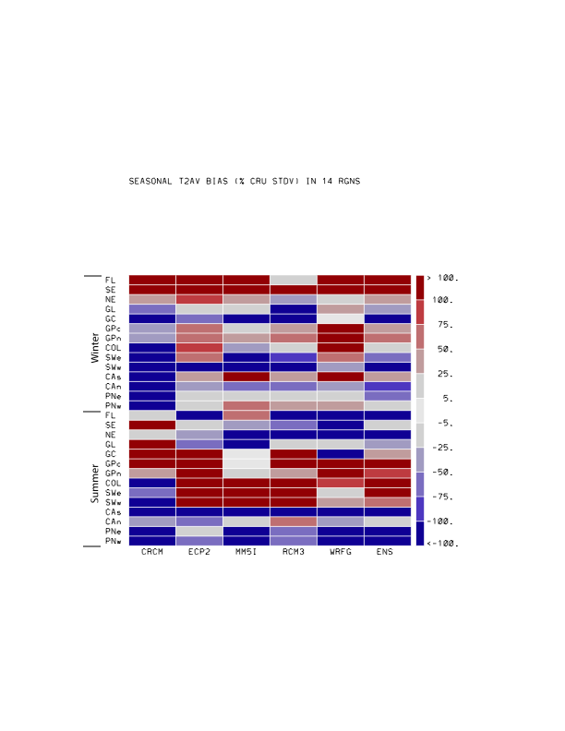
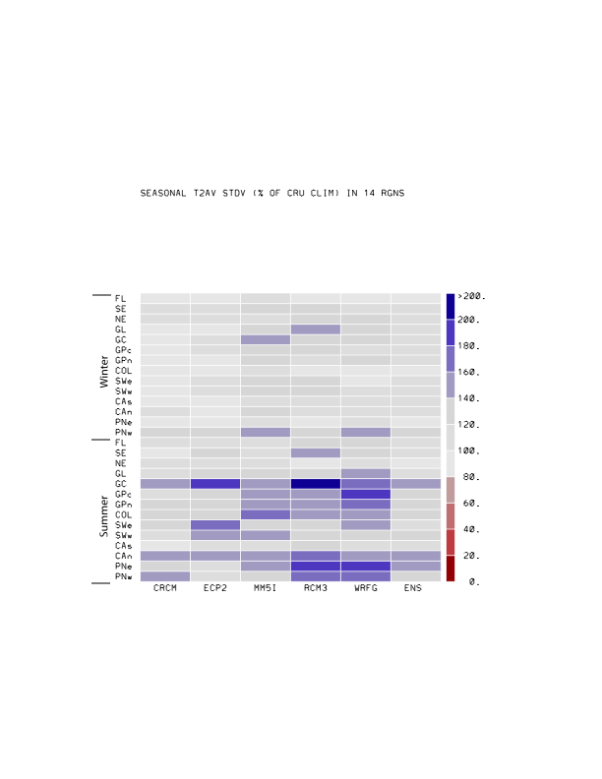
Seasonal surface air temperature climatology:
Normalized bias & interannual variability
(a) Bias (% the CRU STDDEV)
(b) Standard deviations (% the CRU STDDEV)
Mean biases vary, quite systematically, according to geography and season
Warm biases in the Great Plains area for both summer and winter
Cold biases in the Pacific, Gulf, and Atlantic coast regions in summer
Warm biases in the Atlantic coast, Florida and northern California during winter.
All models reasonably simulated the interannual variability of the winter temperatures in almost all regions.
Models generally overestimate the interannual variations in the summertime surface air temperature.
The model ensemble is consistently among the best performers for all seasons, regions, and metrics.

Slide 12
[2] Precipitation evaluation 5 RCMs and their ensemble vs. CRU3.1 analysis
24 years: 1980-2003
Overland only
Annual climatology: Spatial variability
Seasonal climatology: Interannual variability
Annual cycle in subregions.

Slide 13
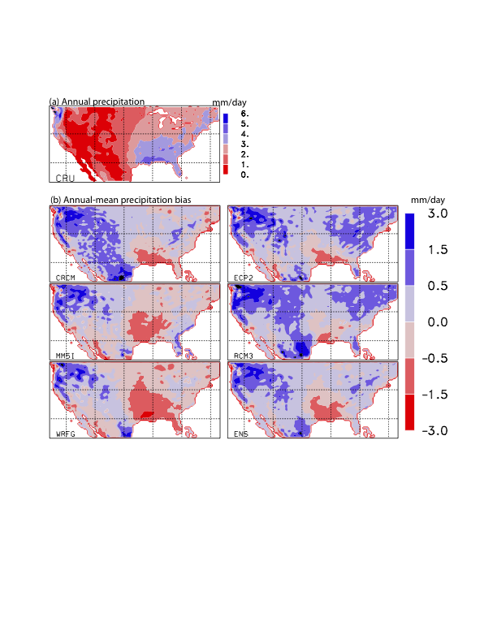
Annual precipitation: Climatology and Biases
Model biases in simulating the annual precipitation climatology also varies according to regions.
The most noticeable systematic biases in the annual precipitation are:
overestimation in the Pacific Northwest region.
underestimation in the Gulf coast and southern Great Plains.
mixed model biases in the Arizona and western New Mexico that is strongly affected by the North American Monsoon (NAM)

Slide 14
Annual precipitation climatology:
Spatial Variability over the land surface
All models show similar performance in simulating spatial patterns with spatial correlation coefficients of 0.75-0.85 with the CRU analysis.
Model performance vary more widely in simulating the spatial variability.
Three out of five models as well as the model ensemble underestimates the spatial variability.
The ratio between the spatial variability of the simulated and CRU data ranges from 0.75 to 1.1.
The model ensemble (marked by a red circle) yields the smallest RMSE.

Slide 15
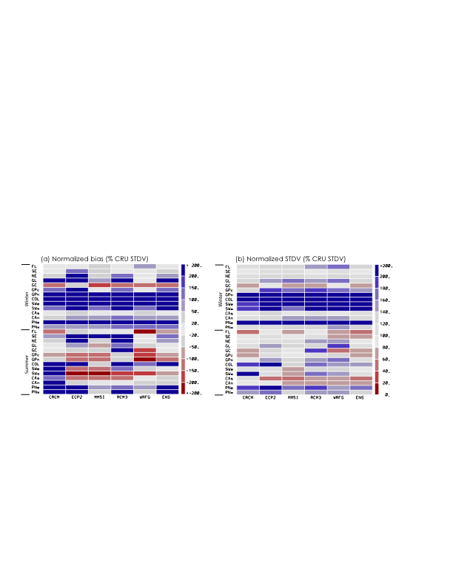
Seasonal precipitation climatology:
Normalized bias and interannual variability
Winter precipitation:
Most models overestimate the mean and interannual variability in the inland regions.
Most models underestimate the mean and interannual variability in GC.
Most models perform well for the Pacific & Atlantic coast regions.
Summer precipitation:
Models generally underestimate the mean in the GP, SWUS, and FL.
Models generally overestimate the mean in the Atlantic coast and Colorado regions.
Large errors in the PNW and CA regions may not be of practical importance.
Model errors show strong regional variations.
Model errors in the seasonal mean and interannual variability are closely related:
overestimations (underestimations) of the mean is usually corresponds to overestimations (underestimations) of the interannual variability, especially for winter.
Notes:
All models (M01-M07) simulates qualitative features of annual mean precipitation in the CRU analysis.
The performance of individual models vary substantially.
The ensemble of all seven models (ENS) compare closely with the CRU analysis.

Slide 16
Summary
Evaluation of climate models is a fundamental step in projecting future climate and assessing their impacts on important sectors.
JPL/NASA is developing RCMES to facilitate RCM evaluation
Monthly-mean surface air temperatures and precipitation from multiple RCMs participating in the NARCCAP hindcast experiment have been evaluated.
It has been found that model errors vary systematically according to regions, seasons, variables, and metrics in addition to models.
Models generate warm and cold biases in the GP and the coastal regions, resp.
The warm biases in the GP region occur in both summer and winter.
In other regions, biases vary according to seasons.
All RCMs generate wet and dry biases in the PNW and GP regions, resp.
All RCMs perform poorly in simulating the summer precipitation in the SWUS region.
Overestimations of seasonal mean precipitation is usually accompanied by overestimations of interannual variability.
The simple model ensemble is typically among the best performer in all evaluations.
The model errors identified in this study can be related to multiple causes including:
The lack of horizontal resolution, model physics, errors in reanalysis data
Need in-depth process studies to identify the causes of model errors.

